Slide 1
Warmdene Surgery PPG Patient Survey 2023
This survey ran from 9th October to 20th October 2023 and was available to complete on paper or electronically via a QR code link in the practice reception area

Slide 2
Key Demographic Statistics
398 patients responded to the survey, compared to 446 last year
45% of respondents were female, with 27% preferring not to disclose their gender (a large rise from only 5% last year) Slide 7
The age group with the highest response rate was age 56-65 (18%), followed by 46-55 (17%). Age 25 and under (6%) were the lowest responders Slide 6
84% of the 398 respondents were White, followed by 8% who again, preferred not to say Slide 8
76% of respondents chose to answer the question about their religion, with 65% of those stating that they had no particular religion Slide 9
91% of responders identified as the sex assigned at birth, with 8% choosing not to say Slide 7
31% of respondents’ day-to-day activities were limited because of health problems/disability, of them 13% were affected a lot. 11% preferred not to say Slide 10
15% of responders were carers with 32% of those carers caring for a parent Slide 11
43% of respondents could give no examples of how to improve the surgery (they were already very happy!)

Slide 3
What works well at Warmdene Surgery?
“I am amazed at the high standard of everything”
“I’ve always been able to get an appointment for myself or my children, and know I can see a GP on the same day if it’s urgent”
“Everything is uploaded online in great detail but easy to understand and at perfect speed. Always felt listened to and never had an issue booking appointments through the NHS app which I didn’t have at my last surgery”
“The staff helpful & kind”
“Everything, no complaints at all”
“Brilliant surgery. Reception very helpful. Doctors and nursing staff fantastic”
“…you can call in the morning and see the GP the same day. Also, it’s great that we can see the GPs face to face. I work in healthcare and many patients tell me they cannot see their GP face to face, so I feel very lucky”
“10/10”
“staff are amazing and quick to get issue sorted”
“well run”
“online booking…book two weeks in advance. The warm welcome from all staff encountered and having a queuing system when calling
”
“Everything always seems organised & Efficient”
“Cordiality, professionalism and appointment availability”
“the doctors are friendly and professional, and I feel confident in them concerning my health”
“being able to see your own doctor, appointments running on time, opportunity to wait at end of surgery if an emergency appt need”
“Booking same day appointments. Receptionists excellent”
“It is such a relief and a blessing to be able to be seen on the same day”
“They are very efficient and sufficient at all times and always there for their patients and have made me feel important…”
“It's fantastic, I cannot find anything wrong with this practice”
“I can always get an appointment when I need to, even if it means booking a few weeks in advance. I like receiving SMS messages and being able to book online”
“Reception. Service. Politeness. Cheerful. Doctor’s manner”

Slide 4
What do you think needs improving at Warmdene Surgery?
“The booking system and appointments. I miss speaking to the doctor over the phone. Sometimes I've not needed to come in, but have and it could have been a phone appt”
“Phone lines busy a lot of the time”
“Recorded message on telephone is too long - maybe it has to be.
Sometimes phone takes a long time to be answered but usually it is fine”
“Improved mental health services and signposting…
Longer appointments for mental health and follow up checks. Support during perimenopause”
“Car parking at busy times”
“Turn-around times for admin activities i.e. typing letters medical records release etc.
Typically, the doctors have said 'by the end of week' and it’s been 9 working days till it is ready”
“The car park needs improving”
“Things to do/watch whilst waiting”
“Automated check in can be unreliable”
“parking”
“Ability to book appointments more than 2 weeks in advance”
“Information about when best to ring for non-emergency appointments”
“…Results are communicated by text with little explanation of what it actually means”
“More doctors”
“Online booking/cancelling service
8am mad rush for appointments”
“Sometimes hard to get an appt with Dr of choice due to working hours (both mine and theirs)”
“Sometimes when waiting at the desk, it can take a while for the receptionist to come back out as they cannot see us”
“Waiting area - chairs arrangement straight lines - could be much nicer and where do the children go?”
“More online appts”

Slide 5
What would help to improve patient experience in the future?
“Better appointment system, less wait time on the phone, more access to online booking”
“I really can't think of anything apart from perhaps the phone situation”
“…find a way to have more parking, it tends to be a bit stressful before coming in meaning I have to leave home well before my appointment "
“Being able to book without feeling under time pressure”
“To be fair, overall, the surgery is amazing”
“Notice boards more interesting and stand out
“Some light classical music in the waiting room.
Children's toys”
“Longer opening hours”
“More verbal communication when results are being given”
“Maybe I need to find out but if I can manage appointments via an app/website it saves me time calling and waiting on hold”
“Booking a doctor within days rather than weeks”
“Easy check-in, self-weights and height…GP in London got a machine which can calculate fat or blood pressure. More information of current disease”
“More holistic approach to health advice”
“More comfortable seats in reception”
“A screen to say how long they are running late, able to advise work if people are working…”
“Perhaps more information leaflets”
“Being able to book appointments online including for children”
“Honestly I have no complaints about this surgery”

Slide 6
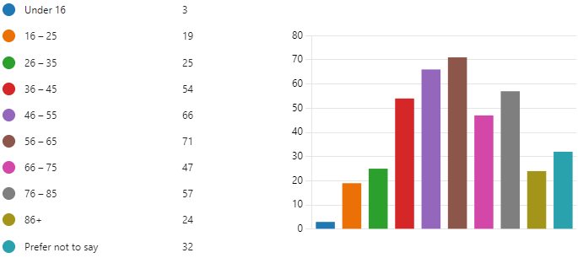
Age of Respondents
Key themes:
60% of the highest responding age group (56-65) were female
Only 12% of responders were under 35
13% of patients sighted issues with parking, with 30% of these being in the 46-55 age group
The age group most impacted by a disability was age 76-85 accounting for 25% of patients with a disability
The age group that had the highest percentage of carers was 56-65 accounting for 28% of carers

Slide 7
Gender of Respondents
Identifying with Sex Assigned at Birth

Slide 8
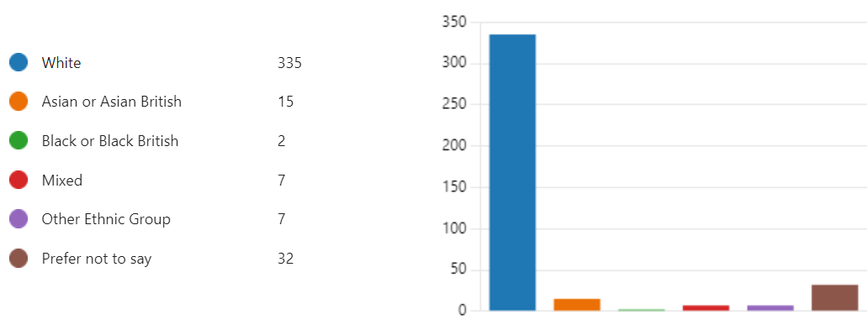
Ethnicity of Respondents

Slide 9
Religion of Respondents (self-described)

Slide 10
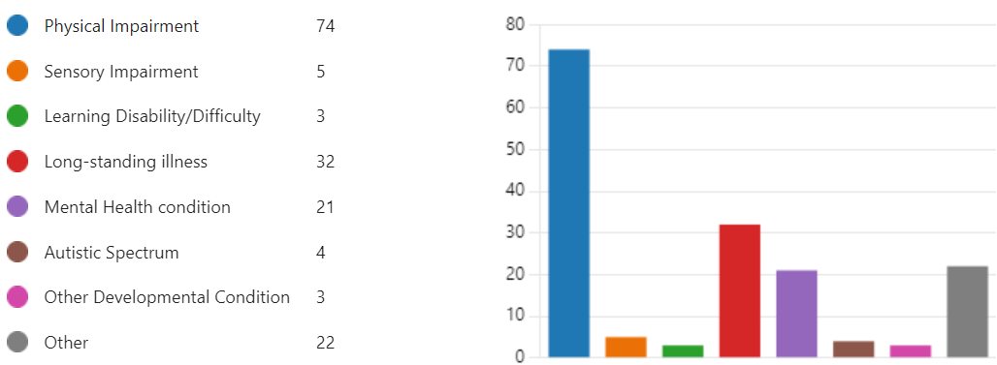
Are day-to-day activities limited due to health problems/disability?
Please state the type of impairment

Slide 11
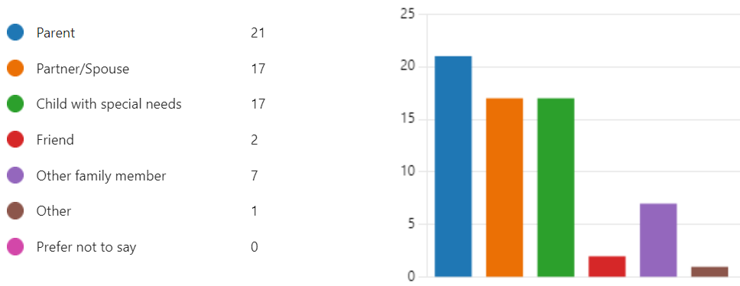
Are you a carer?
Who do you care for?

